Slide 1
India & Neighbours
PPG Bilateral Lending 2000 - 2020
By Umar Shaikh

Slide 2
What is PPG Bilateral Debt?
Public and publicly guaranteed debt refers to long-term external commitments of public debtors.
It includes debt guaranteed by the national government, public corporations, state-owned enterprises, development banks and other mixed enterprises, political subdivisions (or their agencies), autonomous public bodies, and private debtors' external obligations guaranteed for repayment by a public entity.
External debt influences a country's creditworthiness and investor perceptions.
Total debt service is compared to a country's ability to generate foreign cash through exports of products, services, primary income, and worker remittances.

Slide 3
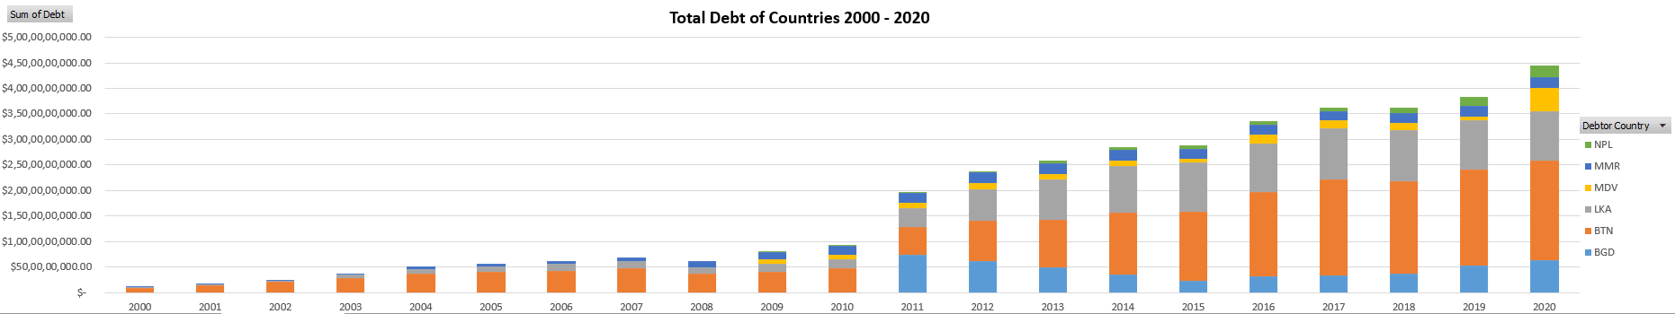
India & Neighbouring Countries PPG Bilateral Lending 2000 - 2020
Between the years 2000 and 2007, YoY growth has been moderate and constant.
2008 indicates a decline in loans due to the Economic Crisis of 2008.
YoY increase has reached highest from 2010 onward.

Slide 4
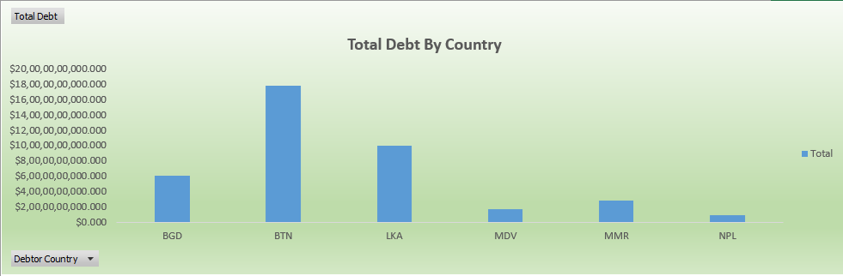
India & Neighbouring Countries PPG Bilateral Lending 2000 – 2020 Total Debt By Country
Bhutan has the biggest share of bilateral loans, totaling to approximately 18 billion US dollars.
Nepal has the least share of bilateral loans, totaling to approximately 1 billion US dollars.
Total bilateral loan by India amounts to approximately 45 billion US dollars.

Slide 5
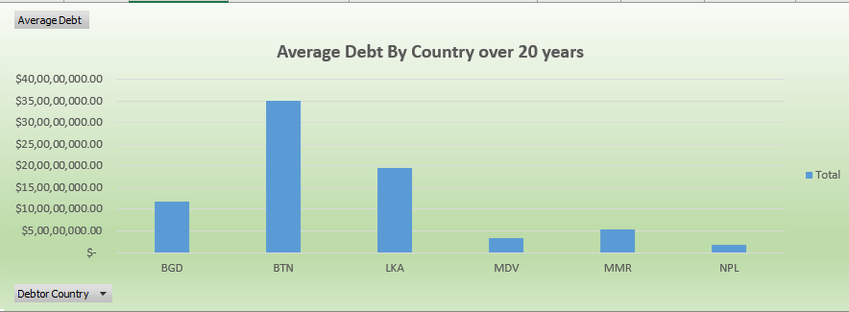
India & Neighbouring Countries PPG Bilateral Lending 2000 – 2020 Average Debt By Country over 20 years
Bhutan has the biggest share of bilateral loans, amounting to almost 3.5 billion US dollars each year.
Nepal has the least share of bilateral loans, amounting to approximately 250 million US dollars each year.
Over a 20-year period, India's average bilateral credit amount is approximately 13 billion US dollars.

Slide 6
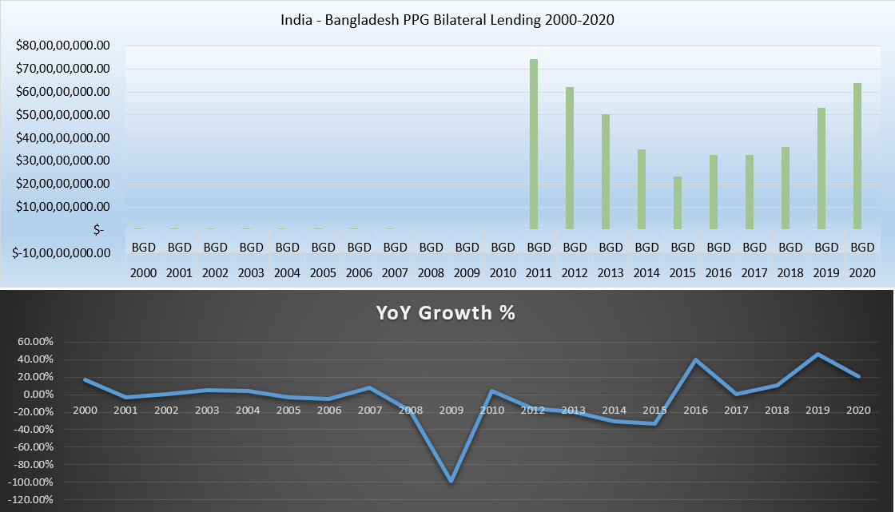
India – Bangladesh PPG Bilateral Lending 2000 - 2020
Bangladesh's total debt amounts to approximately 6 billion US dollars.
Bilateral financing has substantially increased after 2010, reducing again until 2015.

Slide 7
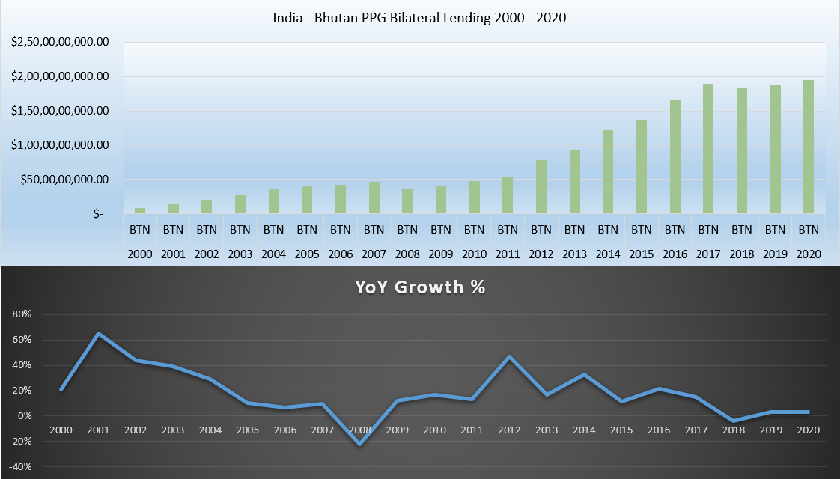
India – Bhutan PPG Bilateral Lending 2000 - 2020
Bhutan's total debt amounts to approximately 18 billion US dollars.
Bilateral lending has gradually increased throughout the years.

Slide 8
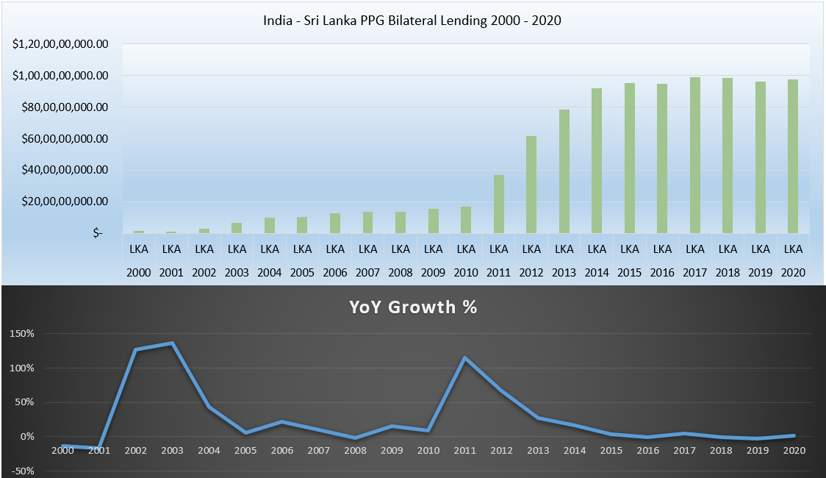
India – Sri Lanka PPG Bilateral Lending 2000 - 2020
Sri Lanka's total debt amounts to approximately 9.5 billion US dollars.
Bilateral lending has significantly expanded throughout 2010 - 2015 and remained stable until 2020.

Slide 9
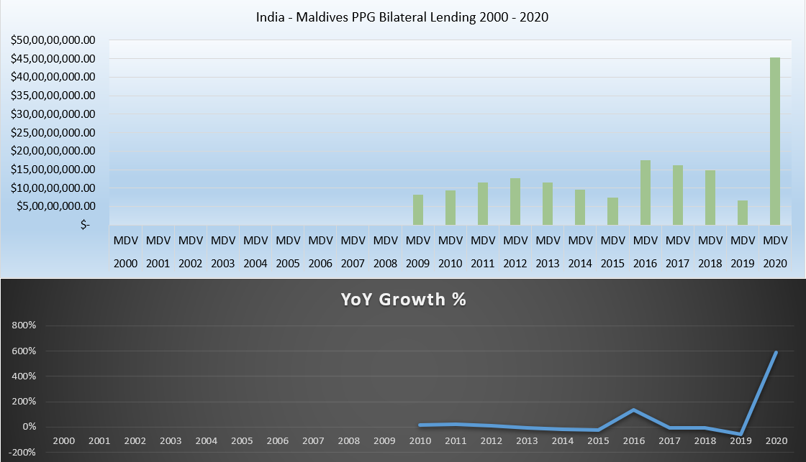
India – Maldives PPG Bilateral Lending 2000 - 2020
The total debt of the Maldives amounts to approximately 1.8 billion US dollars.
Bilateral lending has quickly expanded since 2008, with a big spike in 2020.

Slide 10
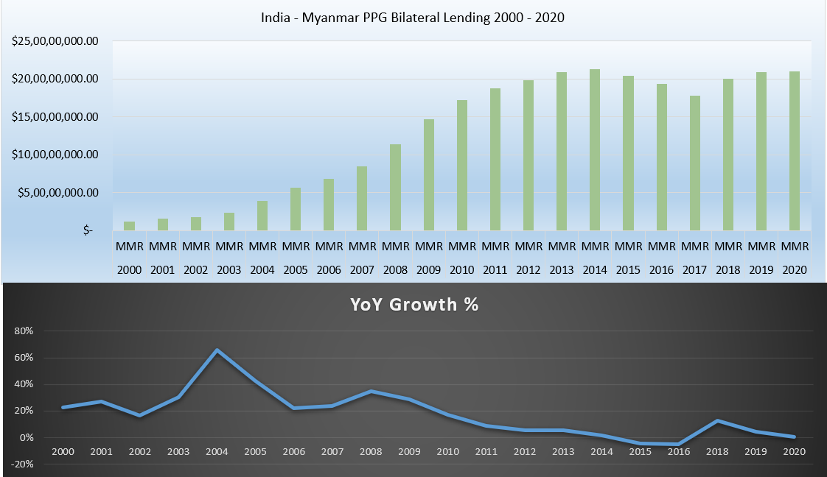
India – Myanmar PPG Bilateral Lending 2000 - 2020
Myanmar's total debt amounts to approximately 2.8 billion US dollars.
Bilateral loan has consistently increased since 2000, with a modest fall during 2015–2017.

Slide 11
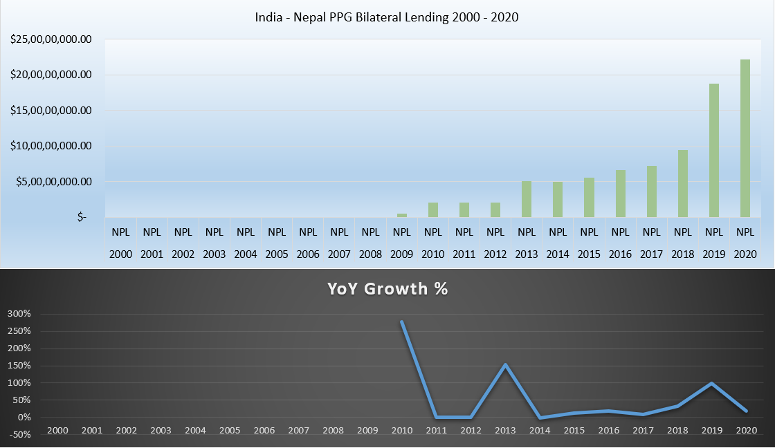
India – Nepal PPG Bilateral Lending 2000 - 2020
Nepal's total debt amounts to approximately 90 million US dollars.
Bilateral financing has dramatically expanded since 2008.

Slide 12
Conclusion
Total PPG Bilateral Lending has climbed from less than 500 million dollars in 2000 to around 45 billion dollars by 2020.
Bhutan has been the largest indebted country, receiving about 18 billion dollars over a period of 20 years.
Nepal has gotten the least bilateral lending, amounting to less than one billion dollars.
Total bilateral loan has shown a positive growth rate over the last 20 years.
Total bilateral loan to surrounding countries is around 1.2% of the overall GDP of India.
The impact of any future default by a neighbouring country on India's banking system will be negligible.

